Slide 1

METIS: PROJECT LUTHER
Eric Xu

Slide 2

CLIENT
Horror film producer
Notes:
- Horror

Slide 3
CLIENT
Horror film producer
Process of choosing
  Horror film to produce
  Studio/Distributor
Plans to wide release film
Notes:
- Horror

Slide 4

CLIENT’S REQUEST
“Please provide me insight as to how I can increase the profit of the horror film I choose to produce.”
Notes:
R.O.I. = return on investment

Slide 5


DATASET
All horror genre films from
Notes:
These only include those with production budgets in order to assess profits and return of investment

Slide 6
DATASET
Dependent Variable
$$$ ADJUSTED PROFIT $$$
=
(gross – budget) / (months since film release)

Slide 7
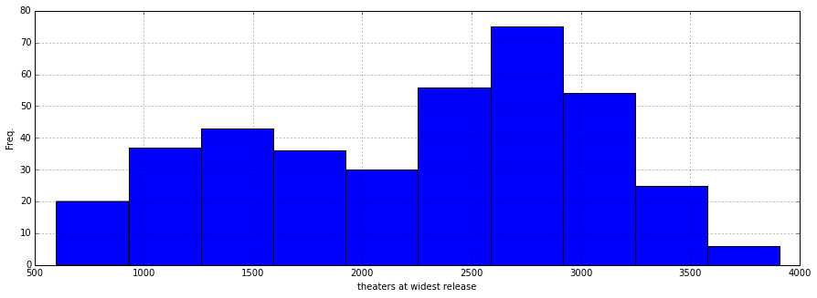

FEATURES
# of Theaters Released

Slide 8

FEATURES
Month of Release

Slide 9






FEATURES
Studio/Distributor
Major conglomerate?
Notes:
Does choosing one of the major 6 conglomerates (shown here) matter?
Are you better off choosing a minor studio that also wide releases films?

Slide 10

FEATURES
Runtime of movie

Slide 11
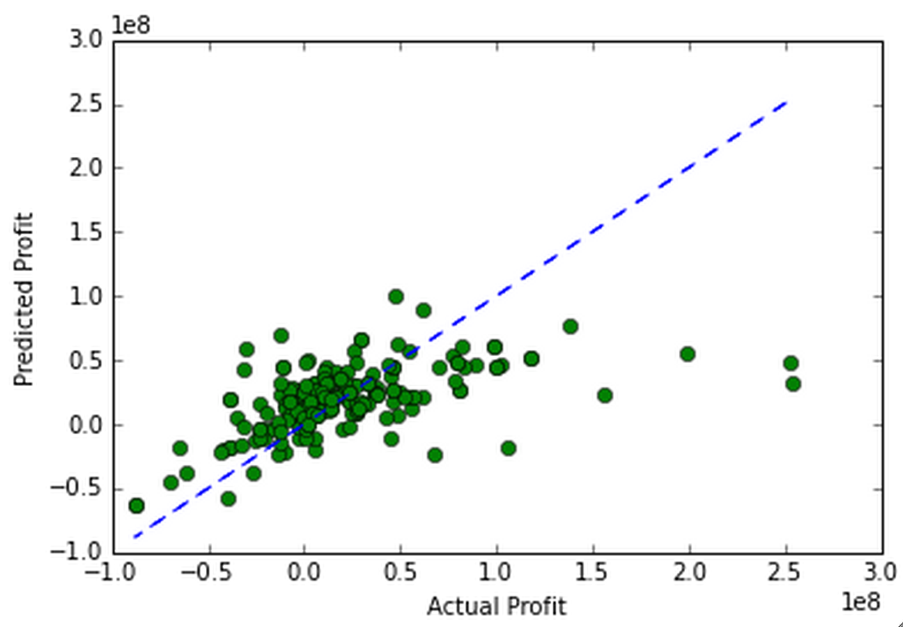
RESULTS
R² = 0.296
MODEL AGAINST PREDICTIONS
Actual Profit

Slide 12
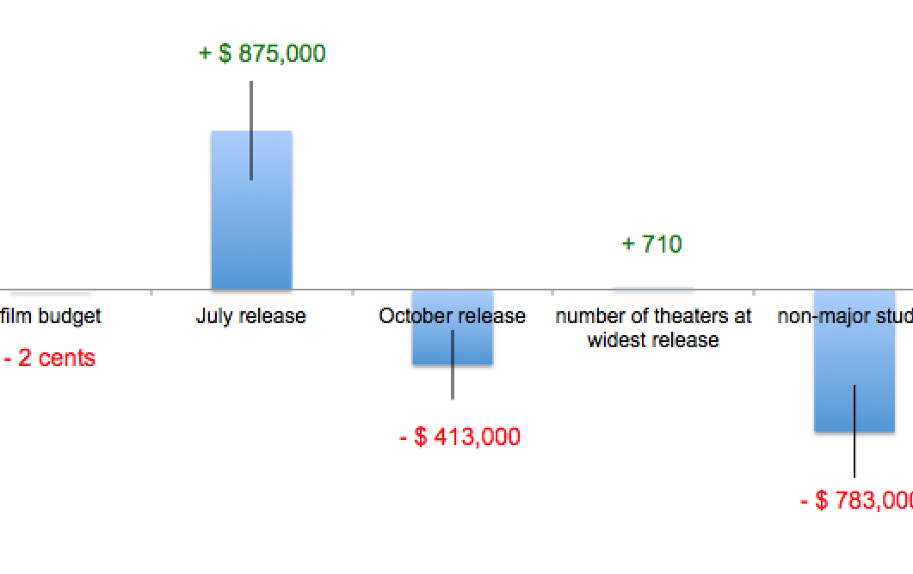
RESULTS
Adjusted Profit/Loss
Per Month

Slide 13
INSIGHTS
Avoid releasing around Halloween, release in summer around July!
Choose a major conglomerate studio, like Paramount
Increase number of theaters released if possible, but relatively less important
Don’t worry about runtime of movie and film budget

Slide 14


